Slide 1
Based on the automotive market research that users of Dongchedi are concerned about: How to break the deadlock of ambiguous segmentation and difficult-to-trace potential

Slide 2
CONTENT
01
02
03
04
05
06
Background & Question
Data
Visualization
Cluster Analysis
Desicion Tree
Conclusion

Slide 3

01
Background
&
Question

Slide 4
Macro Background
Global auto industry shifts toward electrification & intelligence
Surge in personalized consumer demands (diverse needs for price, functions, brands)
Intensified market competition — automakers need precise positioning to stand out
Lack of data-driven insights to bridge "market supply vs. user needs" gap
Market Pain Points
Research Value
Blurred segment boundaries with no clear classification criteria
Core drivers behind why high-potential models attract attention remain unclear
Defining market segments through clustering
Identifying core drivers using decision trees

Slide 5
02
Data

Slide 6
Data Scraping
Data Source
Collection Outcomes
Dongchedi Web Interface Scraping: /motor/pc/car/rank_data
Core Data: Vehicle basics + User engagement
File: dongchedi_rank_data.csv
Valid data: 743 vehicle entries
Usage: Cleaning → Clustering → Decision tree
Data Collection Logic
Technical Tools & Libraries
Pagination: Offset (20pages x 50 items/page)
Data List：
  series_id / name, brand_name
  min / max_price
  count, score, rank
Language: Python
Core Libraries:
  Scraping: requests
  Handling: pandas, numpy
  Visualization: matplotlib, seaborn
  Modeling: scikit-learn
  Anti-scraping: time, random
  Auxiliary: warnings

Slide 7
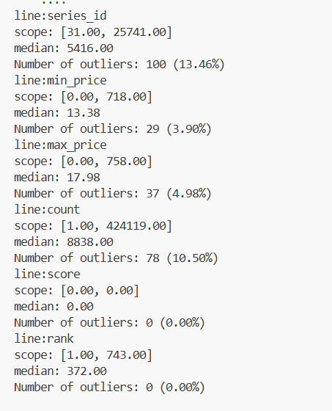
Data Cleaning
 | series_id | min_price | max_price | count | score | rank
count | 743.000000 | 743.000000 | 743.000000 | 743.000000 | 743.0 | 743.000000
mean | 7729.908479 | 17.803674 | 23.572900 | 32895.839838 | 0.0 | 372.000000
std | 7321.686919 | 29.719015 | 32.576032 | 57742.082243 | 0.0 | 214.629914
min | 31.000000 | 0.000000 | 0.000000 | 1.000000 | 0.0 | 1.000000
25% | 3165.000000 | 8.990000 | 12.835000 | 1735.500000 | 0.0 | 186.500000
50% | 5416.000000 | 13.380000 | 17.980000 | 8838.000000 | 0.0 | 372.000000
75% | 9256.000000 | 19.885000 | 26.980000 | 36494.500000 | 0.0 | 557.500000
max | 25741.000000 | 718.000000 | 758.000000 | 424119.000000 | 0.0 | 743.000000
More likely to represent limited-edition luxury cars or popular electric vehicles,
reflecting genuine market trends.

Slide 8
03
Visualization

Slide 9
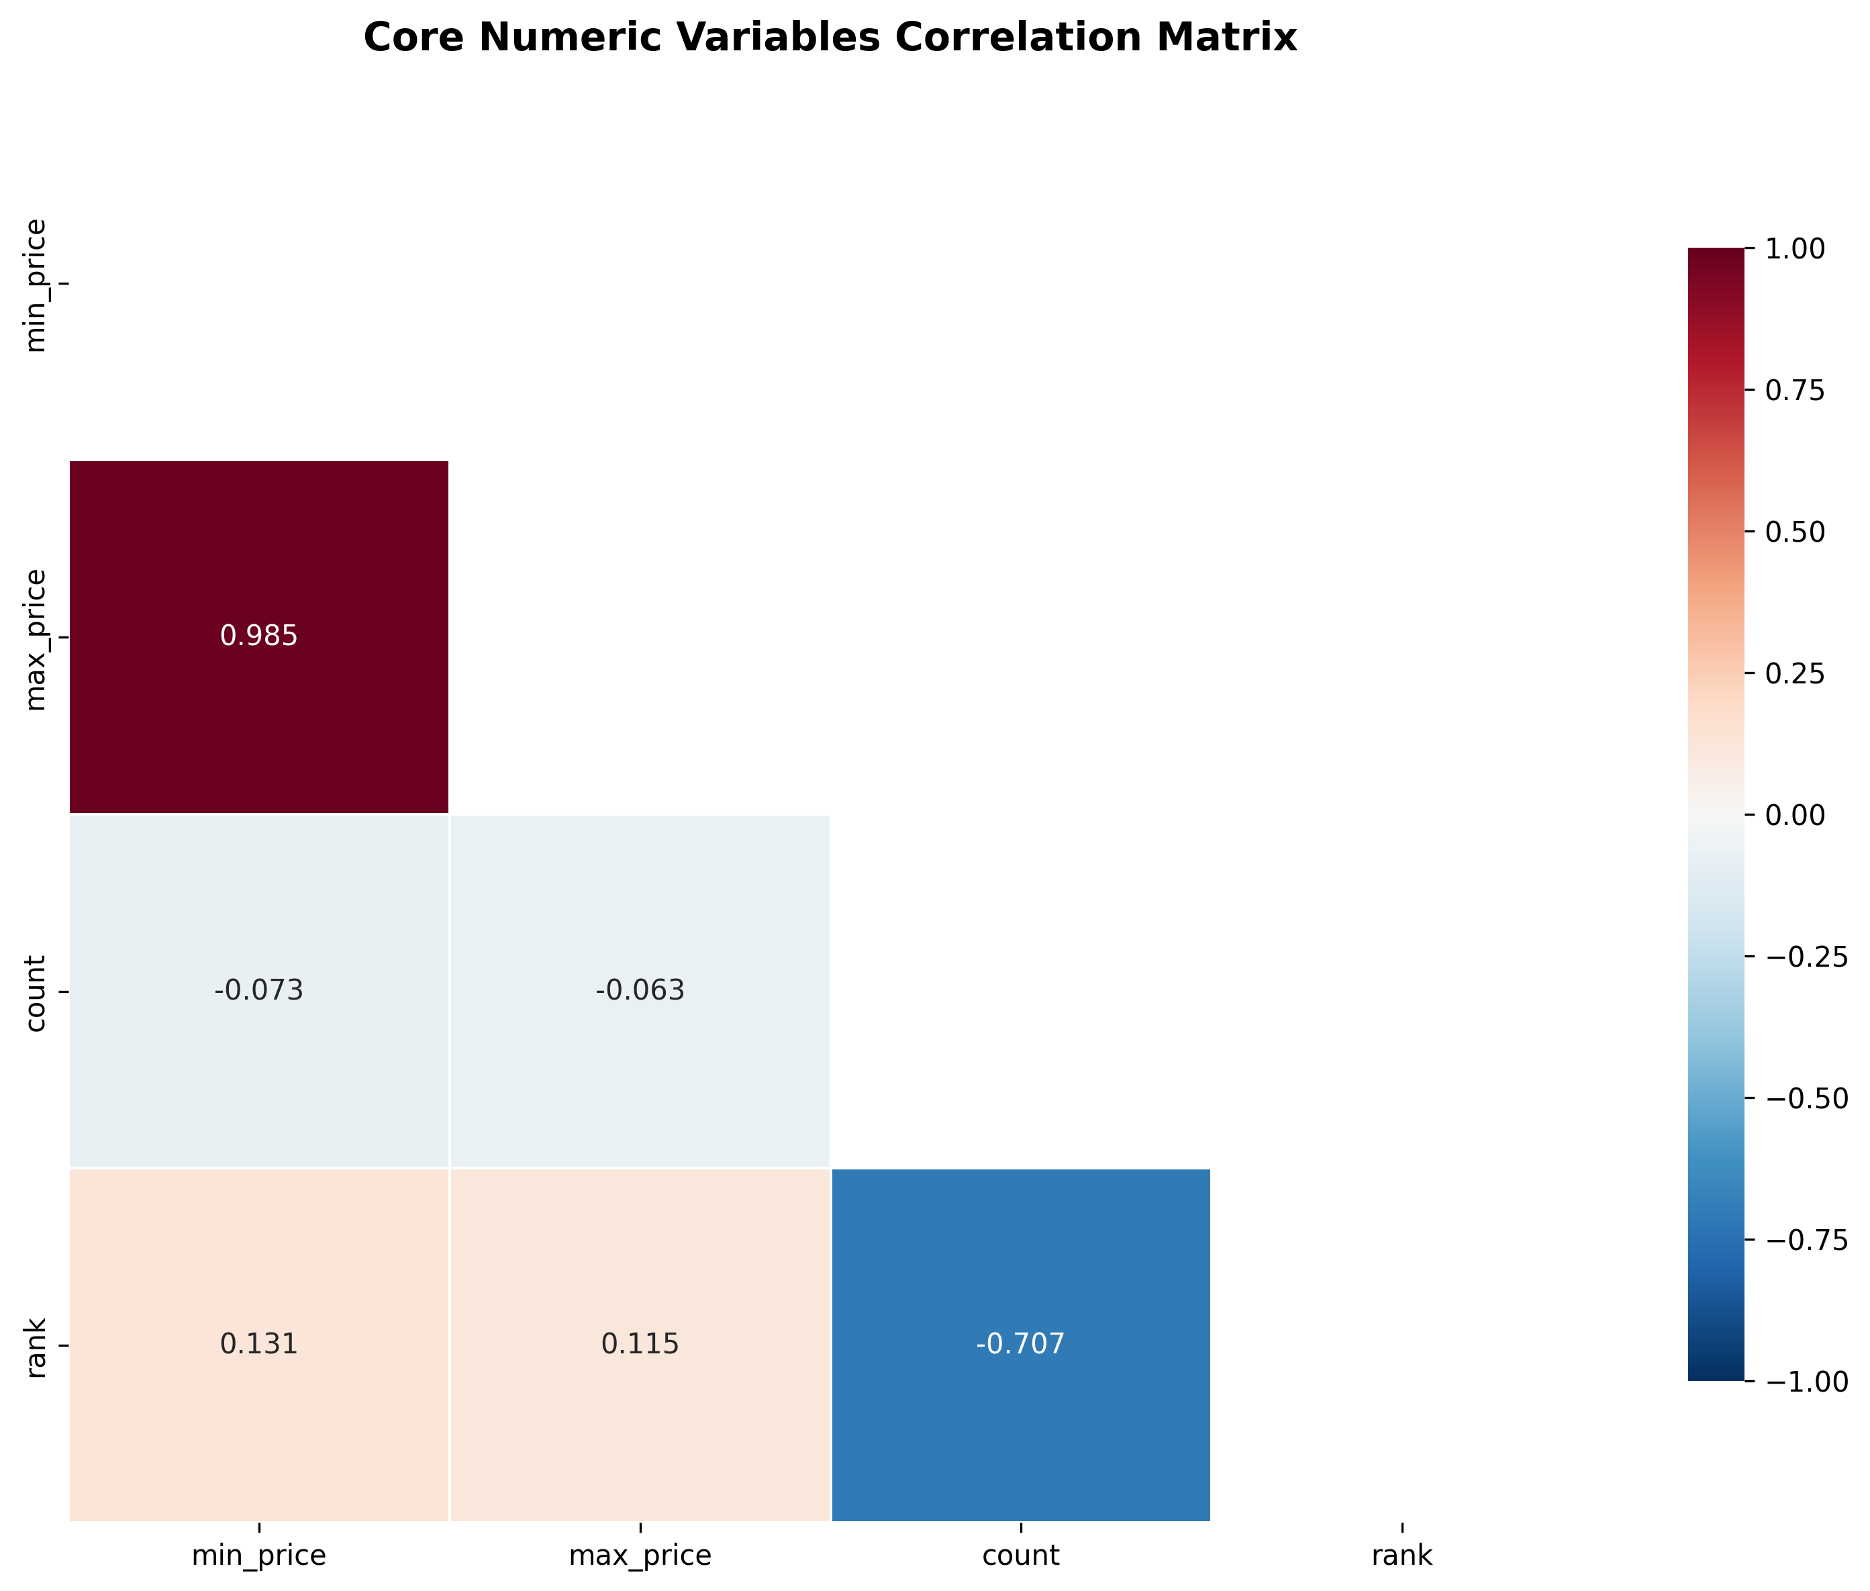
Correlation Matrix
The price range of car models is generally consistent, with higher prices typically corresponding to wider price ranges.
High price cars do not necessarily sell more
The higher the sales volume of a model, the higher its ranking

Slide 10

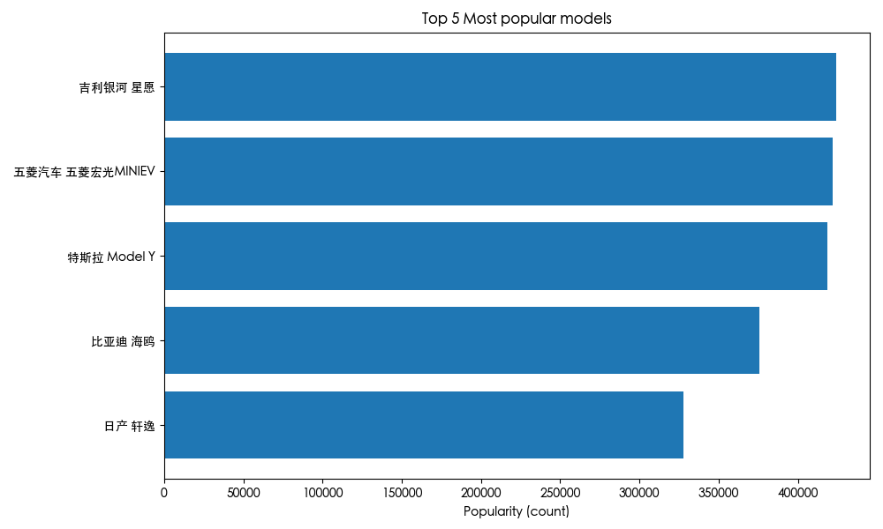
Top 5 popular models
??
What can we know
Key Insights
The popularity gap among the top models is small, especially for the top three, showingstrongcompetition.
Most of the top models are new energy vehicles, suggesting growing user interest in electric cars.

Slide 11
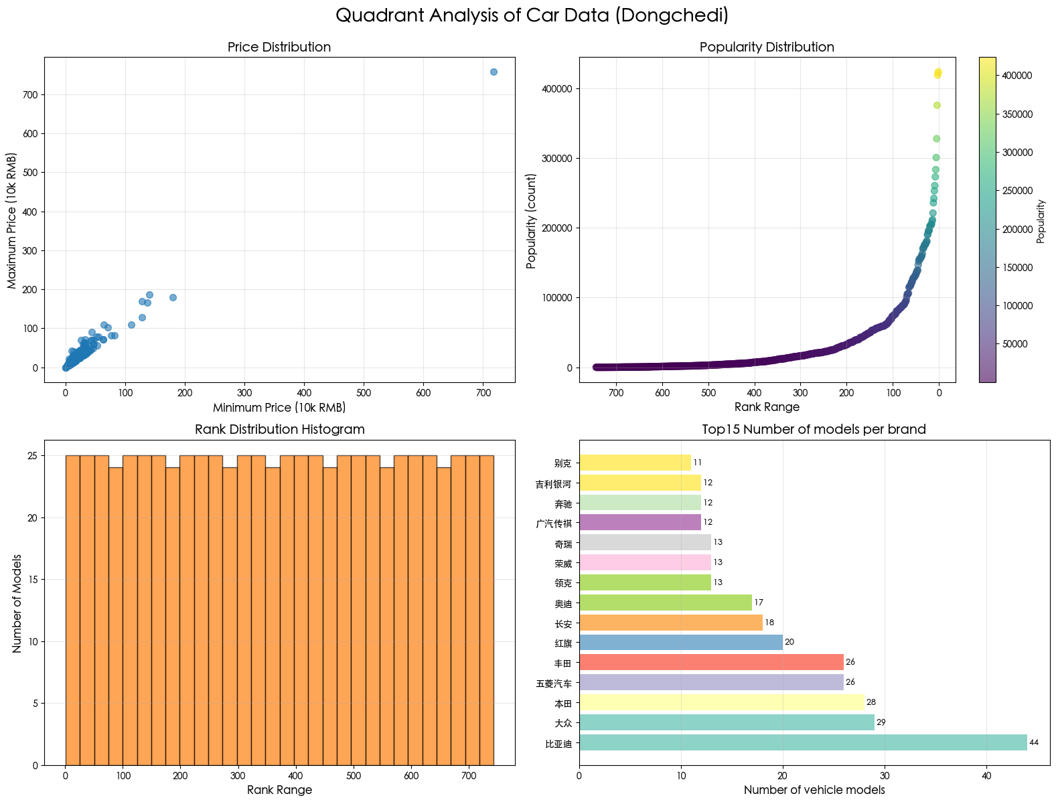
Quadrant Analysis
1️⃣ Price Distribution
Minimum and maximum prices rise together.
Most models cluster in the lower price range.
2️⃣ Popularity Distribution
A few models have very high popularity compared to the rest.
Popularity increases sharply among top-ranked models.
3️⃣ Rank Distribution Histogram
Vehicle counts are evenly spread across rank ranges
No clear concentration or gaps in the ranking distribution
4️⃣ Top 15 Brands by Number of Models
BYD offers significantly more models than other brands.
Most other major brands have a similar number of models.

Slide 12
04
Cluster Analysis

Slide 13
Cluster Analysis
Purpose ：
Use cluster analysis to achieve precise segmentation of the automotive market and clarify the characteristics of different groups
Procedure:
Select "lowest/highest price, attention, ranking" as features → Remove outliers + standardize
Data pre-processing
Choose 'Best K'
Test the contour coefficient with K=2-7 → The optimal K=3
Divides into 3 groups → PCA dimensionality reduction visualizes the results
Clustering + Visualization

Slide 14
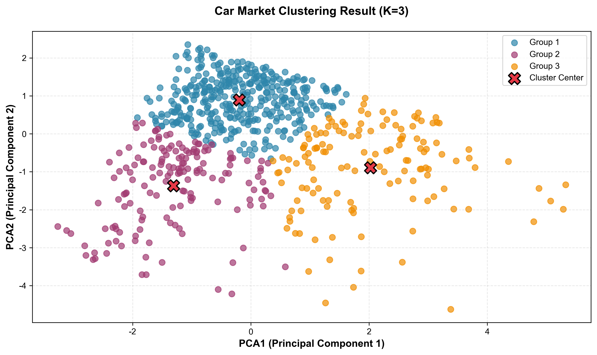
Result
Group1 (56%) :
125,000-167,000 yuan (low price) Low attention: Popular: Honda, Wuling
Group2 (23%) :
116,000-166,000 (low price) High Attention: Popular: BYD, Toyota
Group3 (20%) :
291,000-385,000 yuan (medium to high price) High Attention: Popular: Audi, Denza
Suggestion
For Platform (Dongchedi) :User stratified operation, precisely promoting corresponding vehicle models/content to different groups
For Automakers: Precisely focus resources and reduce marketing costs
For Automotive brands: Clarify their own positioning and optimize competitive strategies

Slide 15
05
Decision Tree

Slide 16

Decision Tree: Core Logic & Features
The decision tree distinguishes between "High Attention" and "Low Attention" vehicles based on two key features:
Brand Type: Categorized into "mainstream brands" and "other brands" (criteria: brands with ≥10 models in the dataset are defined as "mainstream").
Minimum Price: Used to set price thresholds for splitting (e.g., 139k CNY, 452k CNY).

Slide 17
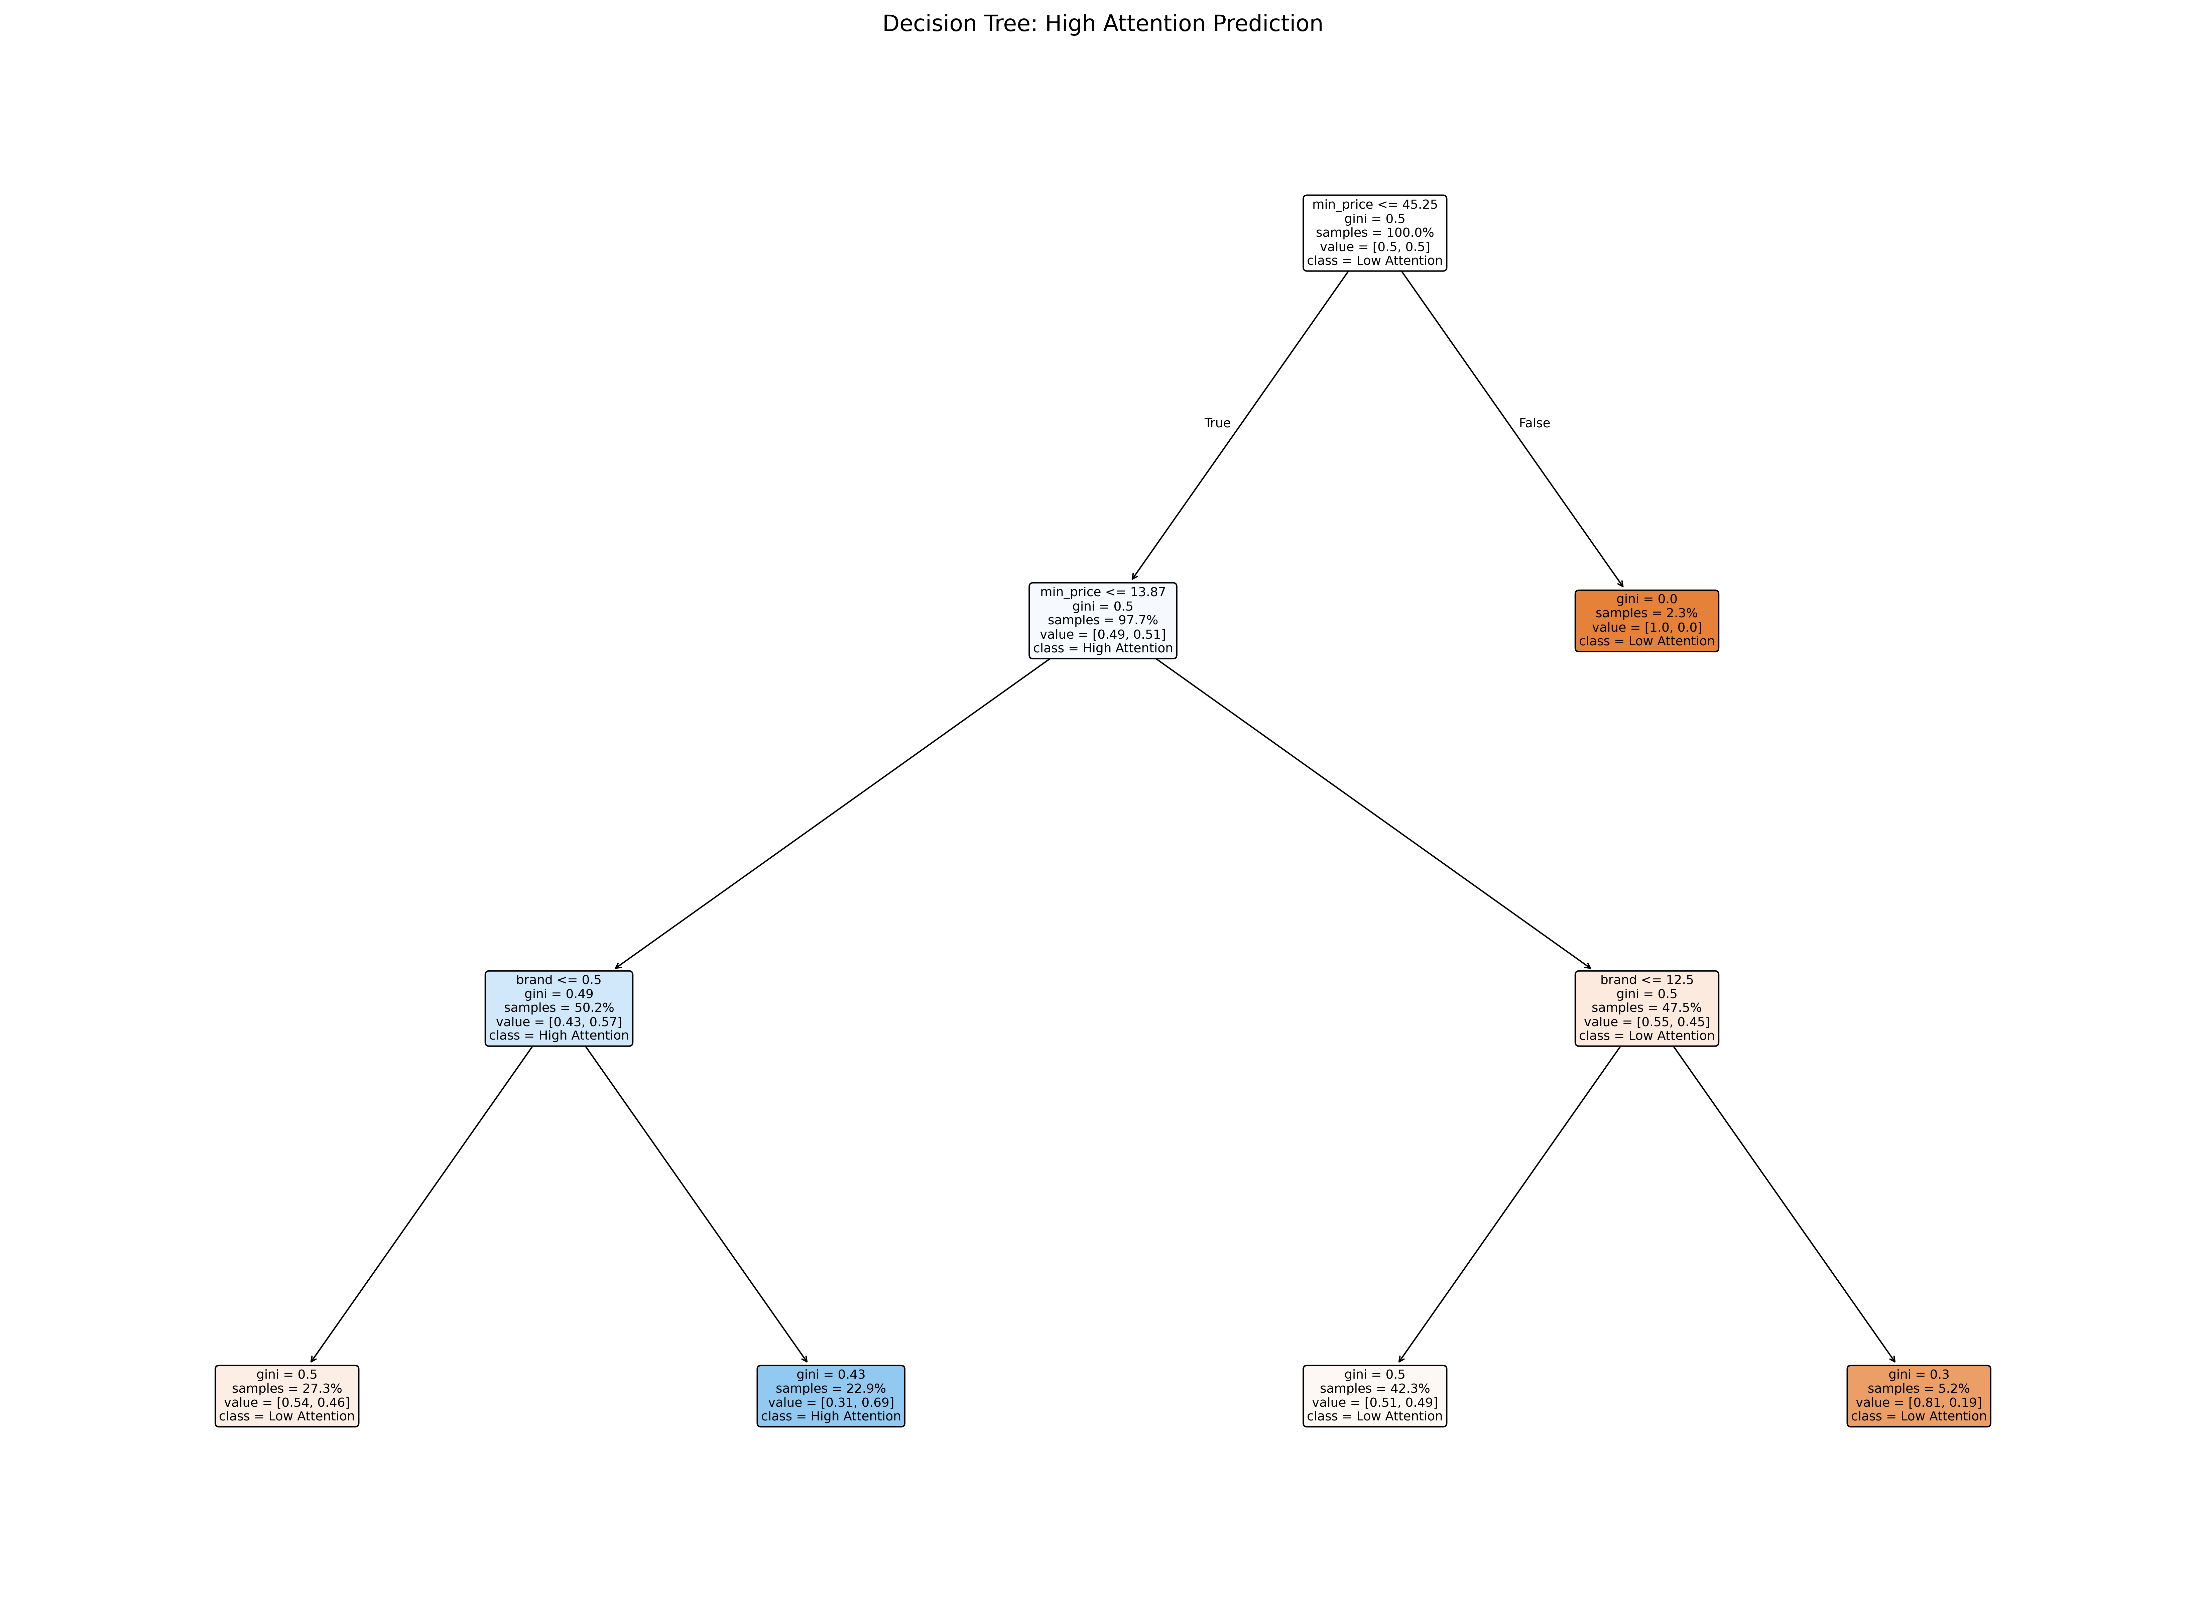
Decision Tree: Key Identification Rules
3 actionable rules derived from the tree:
If Minimum Price ≤ 139k CNY + Brand is mainstream (e.g., Geely Galaxy, Wuling, BYD, Volkswagen) → High Attention Car (Coverage Ratio: 68.9%).
If Minimum Price ≤ 139k CNY + Brand is "other brands" (e.g., rare/less-represented brands) → Low Attention Car (Coverage Ratio: 53.5%).
If Minimum Price > 452k CNY → Low Attention Car (Coverage Ratio: 100%).

Slide 18
Decision Tree: Performance & Business Value
Model Performance (Reliability)
Test Set Accuracy: 61% (overall correct classification rate).
High Attention Recall: 36% (Prioritizes rule interpretability over pure metrics, ensuring practical applicability).
Business Value (Practical Use)
Resolve "Hard to Trace High-Potential Cars": Use Rule 1 (68.9% coverage) to quickly screen promotional models.
Optimize Resource Allocation: Rule 3 (100% coverage) eliminates low-potential high-priced models efficiently.
Strategic Insight: Brand (0.536) ≈ Price (0.464) → Automakers should balance both dimensions for market layout....

Slide 19
06
Conclusion

Slide 20
Precise anchor price band + Focus on high potential models / brands + Quantitative core association rules
The lowest price of a car is highly positively correlated with the highest price , and most models are concentrated in the low to middle price range.
The minimum price ≤250,000 is the core threshold for distinguishing user attention

Slide 21
The market can be clearly divided into three segments：
Affordable vehicles for daily use + Mid-to-high-end new energy vehicles are leading the popularity rankings
Leading brands leverage a dual strategy of 'multi-model coverage + targeted pricing in high-demand segments' to build scale advantages
Targeting the 'below 250,000 yuan price segment' as the key market segment, we focus on the most popular models from leading brands.
Through the standardized model of "price + number of branded models", we can accurately identify and track high-potential market opportunities.

Slide 22
Thanks!

